Slide 1
INBOUND MARKETING

Slide 2
Inbound marketing is anything that attract customer by creating a valuable content and experience tailored the them

Slide 3
Optimizing your website for SEO
Keyword
On page seo
Technical Seo
Link Building

Slide 4
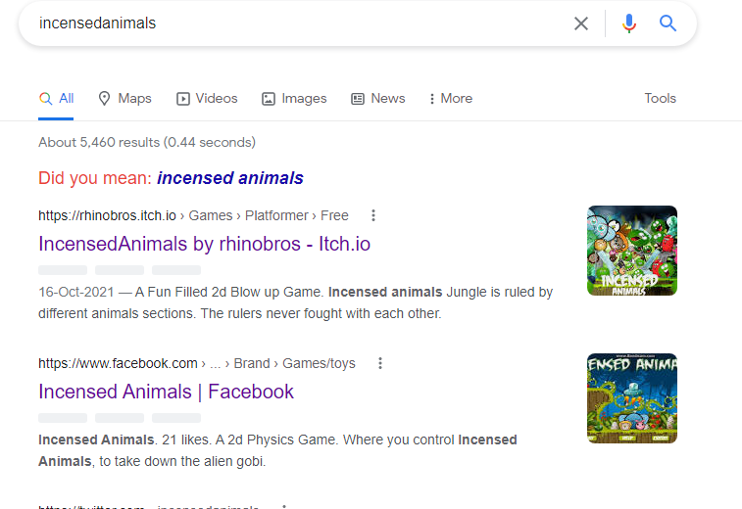
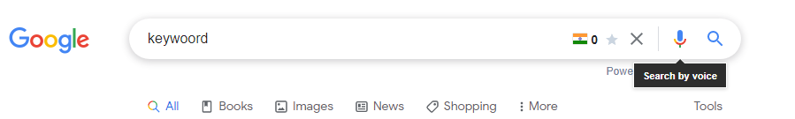
Keyword
Anything that you type in
the search bar of a browser

Slide 5
Checklist for keyword
Search demand
Traffic for that keyword
Keyword difficulty
Relation with business - how relevant it is and is it worth it
Search intent
Determine whether you can rank for the keyword (RD audit )
Look up for the relevant keywords and subtopics

Slide 6
On page seo
Short and descriptive url
Compelling title and meta tag
Add relevant internal and external resources
Alt text
Image names
Structured data
Canonical tag
Content - readability
Sitemap
Robots .txt

Slide 7
Technical seo
Crawling checkup
Indexing checkup
Mobile friendliness
Page speed insight
Https
Server performance
Broken links
Outdated scripts

Slide 8
Fundamentals of blogging
Plan your Blog post
Follow the 3 C’s
Content Type
Content format
Content angle

Slide 9
Content
Include head keyword in description
Long tail variation and synonyms with semantic
Make sure they’re all well written and readable ( Readability )
Tell visitor things they may actually want to know
KISS and use images ,
Use USGC and link to internal and other external
Add schema

Slide 10
Social media
Include a social media link in your website
Use compelling images and post enticing to the viewers that they actually want to engage
Do not fish for engagements
Use more of a video post on social media
Try and use the native only posts

Slide 11
How to create a CTA
in marketing your call to action is the part of your advertisement that tells your target audience what they should be doing once they clinic n your ppc ad and hit your website or landing page the simplest example of a call to action [CTA] is Buy now

Slide 12
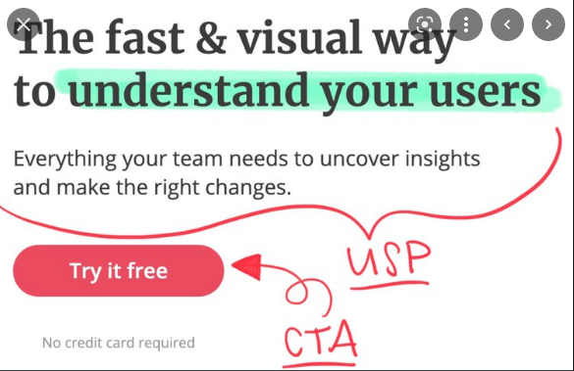

Slide 13
To create a Great CTA
Use a USP
Create a compelling hook line
Use a strong verb - buy now, try , book
Use words or phrases that triggers emotion or use FOMO
Create best Audience journey
Use first pay later (trial )
Freebies

Slide 14
Landing Page
Landing Page is a web page that is developed solely for one purpose it shouldn’t have any redirection pages other than social media, or a relevant pages
Some examples include
https://www.broforcegame.com/
https://rhinobros.itch.io/incensedanimals

Slide 15
Thank you page
This page is most essential for tracking and confirmation. You will have to add your conversion tracking code and even tracking code here to be able to retarget the customer or to know how many conversion happened

